Slide 1
Homework 3 explanation
NCKU CSIE DICLAB

Slide 2
Finite State Machine
IDLE : Reset state
READ : Store the first 16 fir_d values to perform the FFT
CAL : Perform one FFT stage per cycle and continuously storing fir_d
DONE : Finished state
IDLE
READ
CAL
DONE
Counter==15
counter==4 && !fir_valid

Slide 3
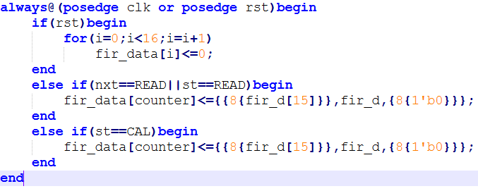
READ
fir_data[0:15]：Store fir_d in buffer when fir_valid is high
Performing sign extension and zero padding simultaneously.

Slide 4
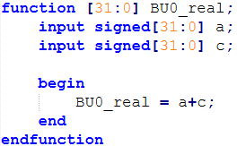
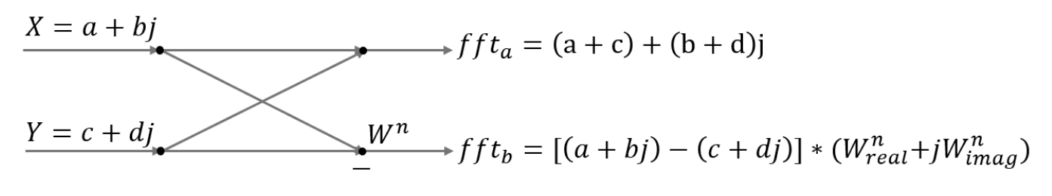
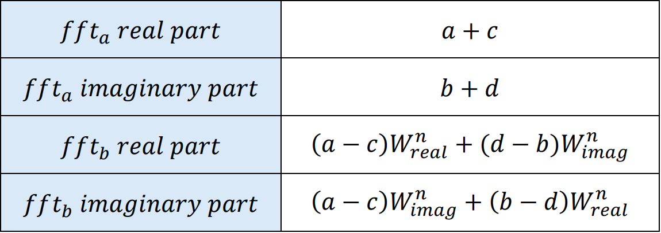
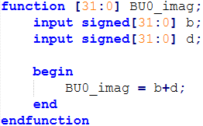
Butterfly unit

Slide 5
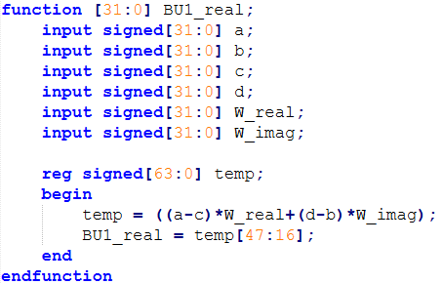
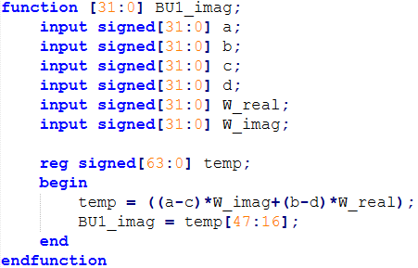
Butterfly unit

Slide 6
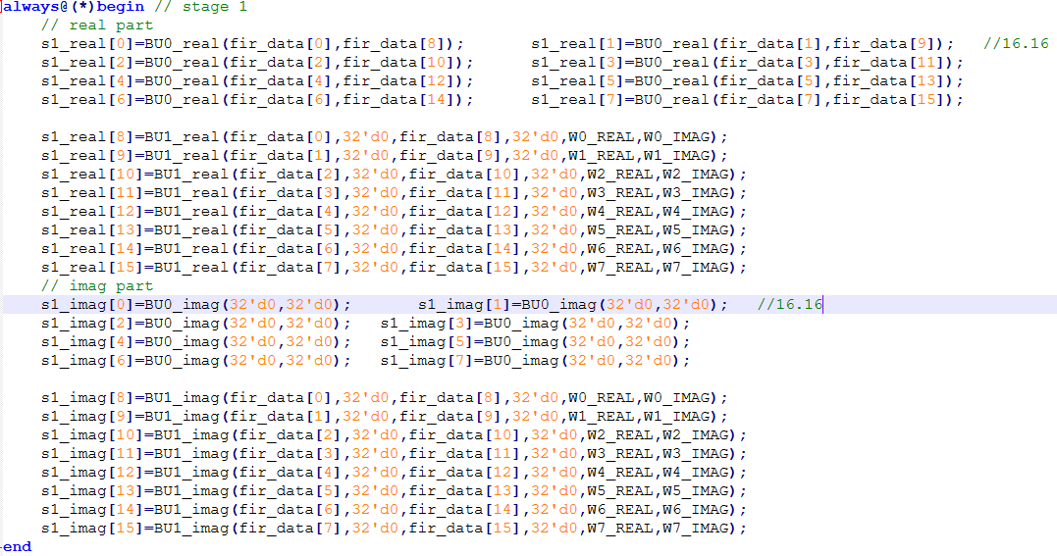
Stage 1
Calculate the result of stage 1 by using previously defined function

Slide 7
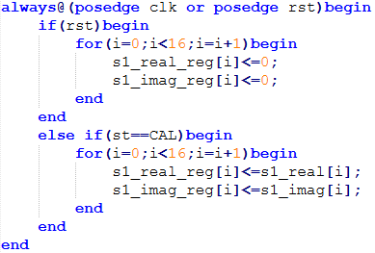
Stage 1
Store the result in the register
Use the output of this stage as the input to the next stage

Slide 8
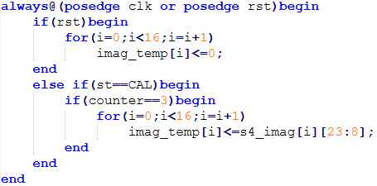
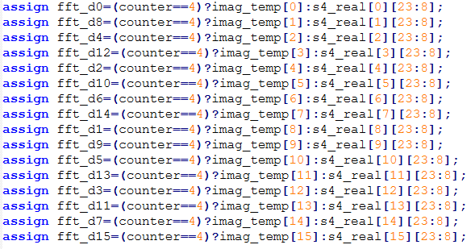
Output
Store the imaginary part in the register
First output the real part, then output the imaginary part

